Slide 1
Titanic: Machine Learning from Disaster
Thanh Hung Duong

Slide 2
Overview
Goal: Use machine learning to create a model that predicts which passengers survived the Titanic shipwreck
On April 15, 1912, during her maiden voyage, the widely considered “unsinkable” RMS Titanic sank after colliding with an iceberg. Unfortunately, there weren’t enough lifeboats for everyone onboard, resulting in the death of 1502 out of 2224 passengers and crew.
While there was some element of luck involved in surviving, it seems some groups of people were more likely to survive than others.
In this challenge, we ask you to build a predictive model that answers the question: “what sorts of people were more likely to survive?” using passenger data (ie name, age, gender, socio-economic class, etc).
The HW6 is a simple model of this competition

Slide 3
Data
Index | Variable | Definition | Key
8 | survival | Survival | 0 = No, 1 = Yes
1 | pclass | Ticket class | 1 = 1st, 2 = 2nd, 3 = 3rd
2 | sex | Sex
3 | Age | Age in years
4 | sibsp | # of siblings / spouses aboard the Titanic
5 | parch | # of parents / children aboard the Titanic
 | ticket | Ticket number
6 | fare | Passenger fare
 | cabin | Cabin number
7 | embarked | Port of Embarkation | C = Cherbourg, Q = Queenstown, S = Southampton
Data is stored in 2 files: train.csv and test.csv ( For the HW the format is xlsx)
Number of cases:
TRAIN set: 891 / 916
TEST set: 418 / 393
→ Same data but different splitting

Slide 4
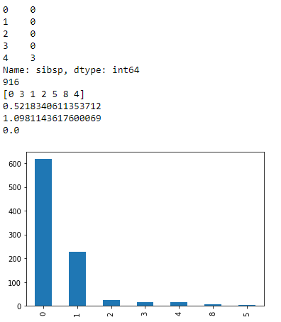
Data exploration
def bas_inf(feat):
print(feat.head())
print(len(feat)) #length of data
#See unique values
print(pd.unique(feat))
# Display histogram of feature
feat.value_counts().plot('bar')
#check whether there is missing data
if np.any(feat.isnull())==False:
if feat.dtypes !='O':
print(np.mean(feat))
print(np.std(feat))
print(np.median(feat))

Slide 5
Algorithms
OneR essentially is a majority voting.
For instance, if the majority of the female passengers (gender = female) in the training set survived the tragedy, the OneR classifies all the females in the test set as survived (1).
If the majority of the male passengers (gender = male) in the training set did not survive the tragedy, the OneR classifies all the males in the test set as not survived (0)
→ Use value_counts function
OR other algorithms in class
Data
Linear Regression
PCA
kNN
Kmean
Hierarchical clustering
Find beta matrix
Prediction
Find k
SVM
Find kernel parameter

Slide 6
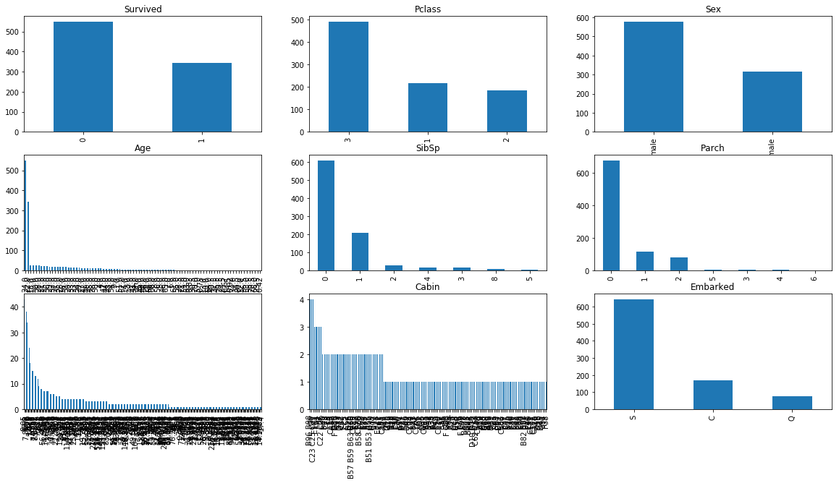

Slide 7
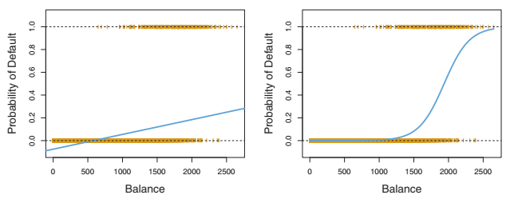
Logistics regression
Why logistics regression?
For binary qualitative response
Why not linear regression by comparing Yhat to 0.5
some of our estimates might be outside the [0, 1] interval
the dummy variable approach cannot be easily extended to accommodate qualitative responses with more than two levels
Logistic regression models the probability that Y belongs to a particular category

Slide 8
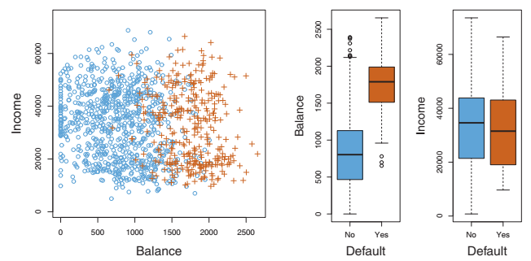
Example
Classification using the simulated Default data set
Goal:Predicting whether an individual will default on his or her credit card payment, on the basis of
annual income,
and monthly credit card balance

Slide 9


Model
A model to predict default (Y ) for any given value of balance (X1) and income (X2)
Pr(default=Yes|balance)=p(balance) = [0,1]
For example, one might predict default=Yes for any individual for whom p(balance) >0.5
Logistic function
Odds: (0,Inf)
For example, on average 1 in 5 people with an odds of 1/4 will default, since p(X) = 0.2 implies an odds of (0.2)/(1-0.2) = 1/4

Slide 10

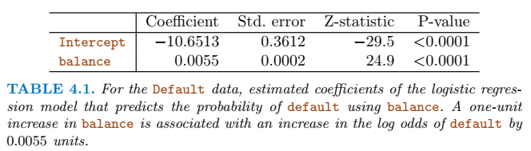

Model
Log-odds/logit
Maximum likelihood is used to estimate beta_hat
For example, an individual with a balance of $1000

Slide 11

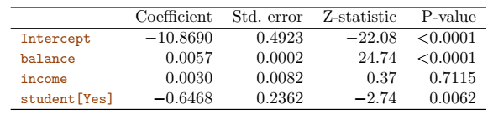
Multiple Logistic Regression
Model

Slide 12
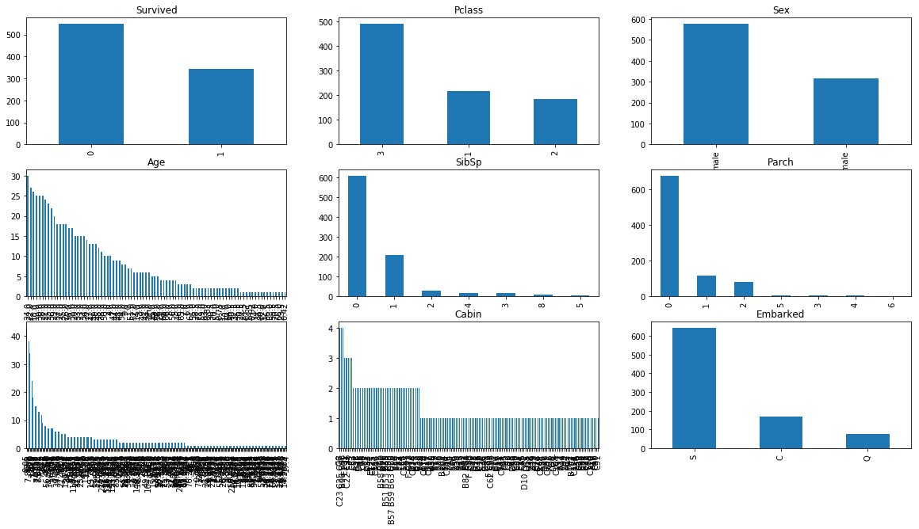
Cleaning data
Features that contains missing data:
Age 177
Cabin 687
Embarked 2

Slide 13
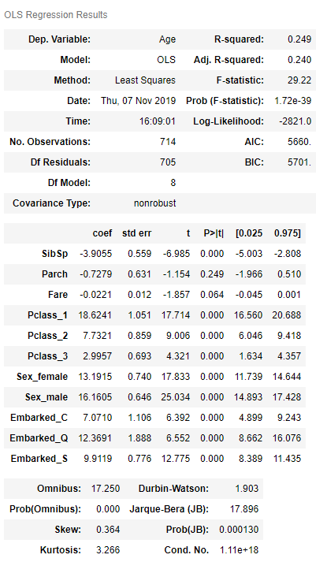
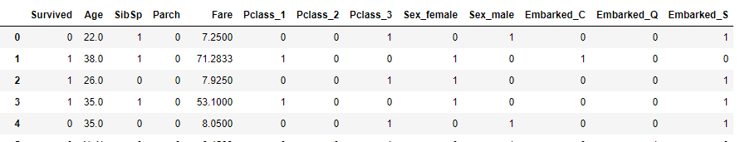
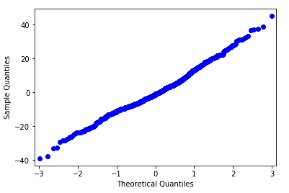
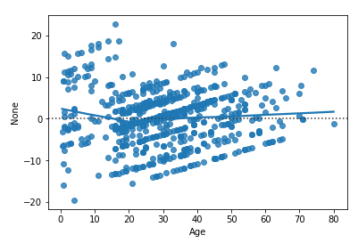
Fill the missing values of Age

Slide 14
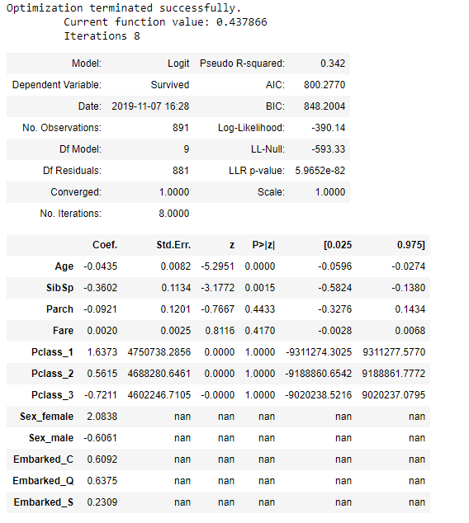
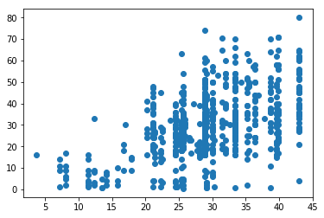
Fill the missing values for Age
Problems

Slide 15
Thank you for your attention

